Slide 1
Data science bootcamp t5
Airline Passenger Satisfaction

Slide 2
outline
Summary
Data set
Work
Conclusion

Slide 3
summary
In this project I chose a data set about an airline and my goal is to predict the level of passenger satisfaction.

Slide 4
Data set
The data size is 3.04 MB
- ID
- Gender
- Customer
- Age
Type of travel
Class
Flight Distance
Inflight wifi service
Departure/Arrival time convenient
Ease of Online booking
Gate location
Food and drink

Slide 5
Data set
Online boarding
Seat comfort
Inflight entertainment
On-board service
Leg room service
Baggage handling
Checkin service
nflight service
Cleanliness
Departure Delay in Minutes
Arrival Delay in Minutes
Target: Satisfaction

Slide 6
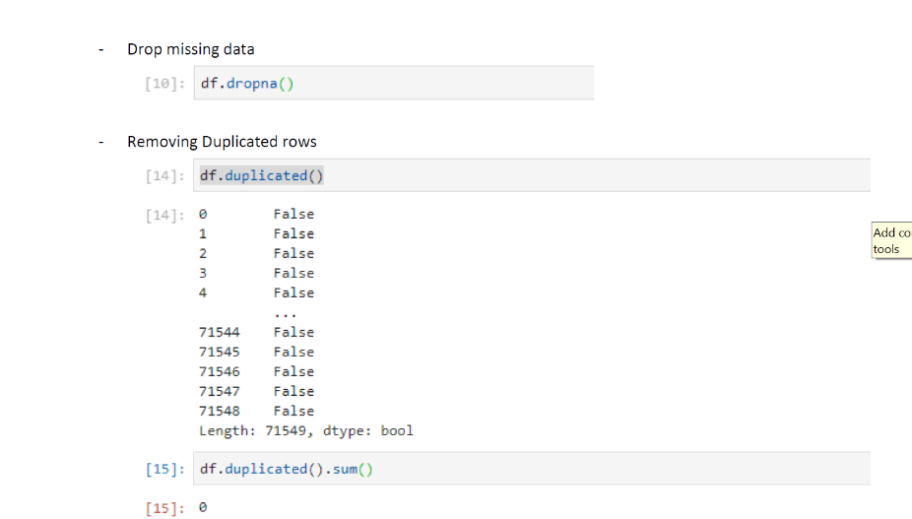
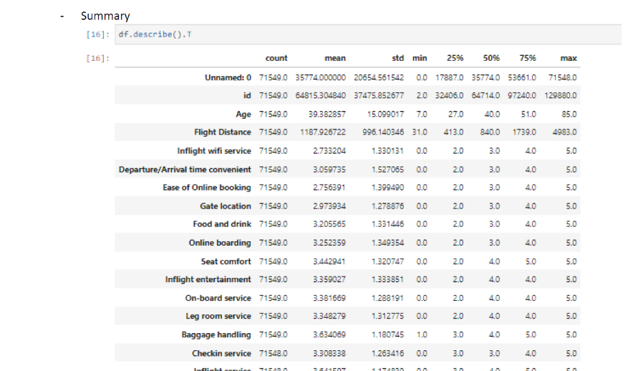
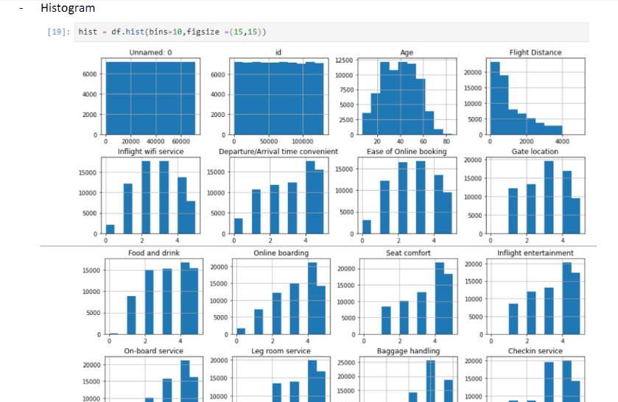
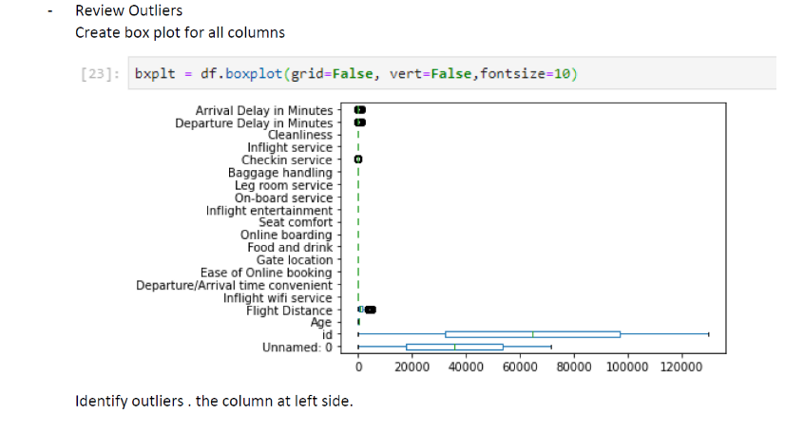
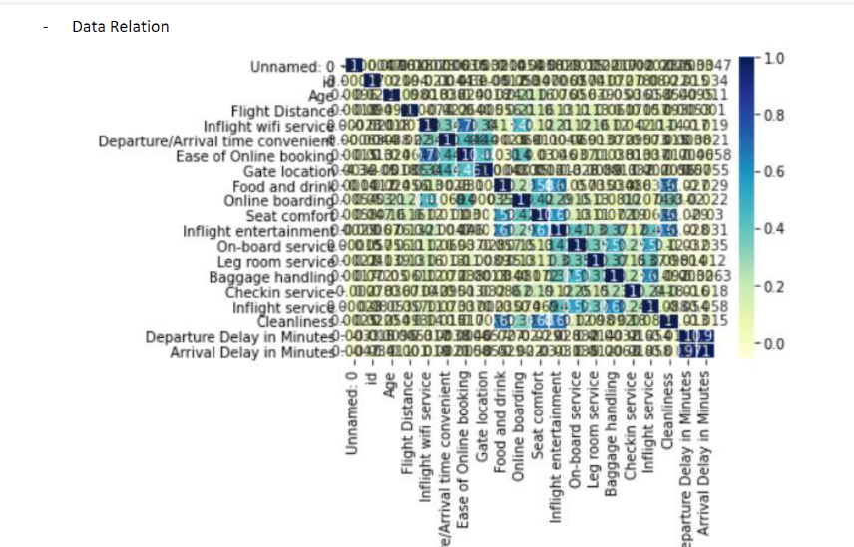
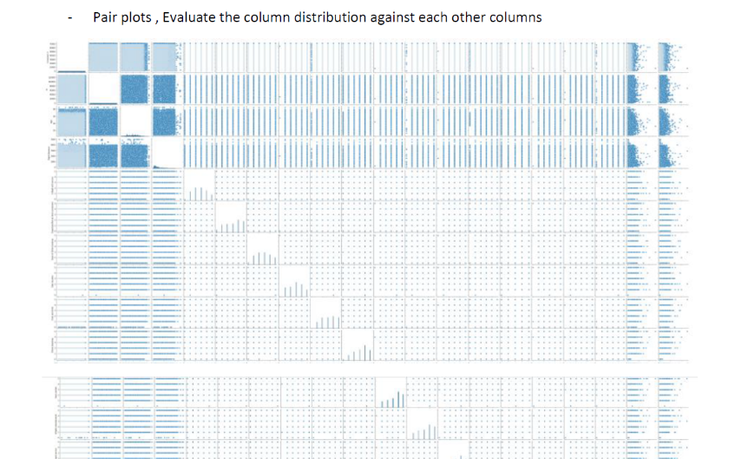
work

Slide 7
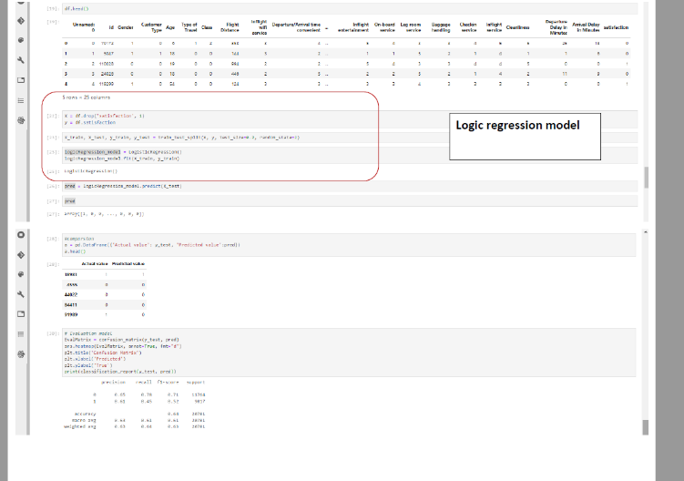
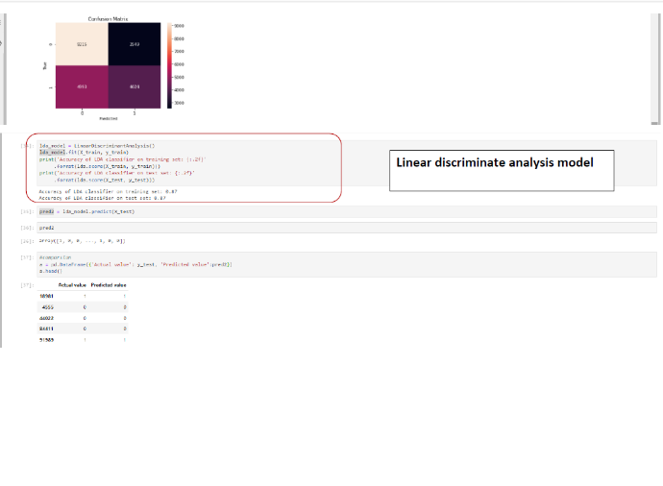
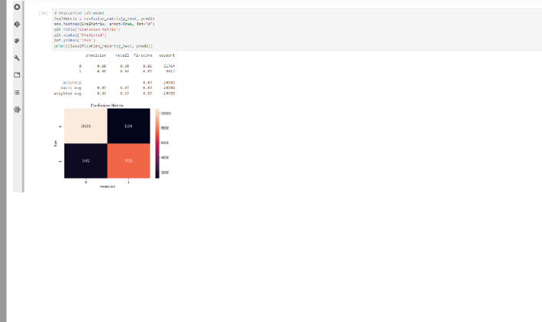
work

Slide 8
Conclusion
During the four weeks of learning, I applied what I learned in my project of data cleaning, analysis and modeling to suit my output based on my data set.

